Slide 1
Algorithm Analysis
with
Big Oh

Slide 2
Algorithm Analysis
  Objectives
    Analyze the efficiency of algorithms
    Analyze a few classic algorithms
      Linear Search, Binary Search, Selection Sort
    Know the differences between O(1), O(n), O(log n), and O(n²)
    Visualize runtime differences with experiments

Slide 3
Algorithms continued
  Computer Scientists focus on problems such as
    How fast do algorithms run
    How much memory does the process require
  Example Applications
    Make the Internet run faster
      Pink-Degemark's routing algorithms
      Gene Meyers determined the sequences of the Human genome using his whole genome shotgun algorithm

Slide 4
Analysis of Algorithms
  We have ways to compare algorithms
    Generally, the larger the problem, the longer it takes the algorithm to complete
    Sorting 100,000 elements can take much more time than sorting 1,000 elements
      and more than 10 times longer
    the variable n suggests the "number of things"
    If an algorithm requires 0.025n² + 0.012n + 0.0005 seconds, just plug in a value for n

Slide 5
A Computational Model
  To summarize algorithm runtimes, we can use a computer independent model
    instructions are executed sequentially
    count all assignments, comparisons, and increments there is infinite memory
    every simple instruction takes one unit of time

Slide 6
Simple Instructions
  Count the simple instructions
    assignments have cost of 1
    comparisons have a cost of 1
    let's count all parts of the loop
for (int j = 0; j < n; j++)
      j=0 has a cost of 1, j<n executes n+1 times,and j++ executes n times for a total cost of 2n+2
    each statement in the repeated part of a loop have have a cost equal to number of iterations

Slide 7
Examples
Cost
sum = 0; -> 1
sum = sum + next; -> 1 Total Cost: 2
Cost
for (int i = 1; i <= n; i++) -> 1 + n+1 + n = 2n+2
sum = sum++; -> n Total Cost: 3n + 2
Cost
k = 0 -> 1
for (int i = 0; i < n; i++) -> 2n+2
for (int j = 0; j < n; j++) -> n(2n+2) = 2n² +2n
k++; -> n² Total Cost: 3n² + 4n + 3`

Slide 8
Total Cost of Sequential Search
Cost
for (int index = 0; index < n; index++) -> 2n + 2
if(searchID.equals(names[index]) -> n
return index; -> 0 or 1
return -1 // if not found -> 0 or 1
Total cost = 3n+3

Slide 9
Different Cases
  The total cost of sequential search is 3n + 3
    But is it always exactly 3n + 3 instructions?
    The last assignment does not always execute
      But does one assignment really matter?
    How many times will the loop actually execute?
      that depends
    If searchID is found at index 0: _____ iterations
      best case
    If searchID is found at index n-1:_____ iterations
      worst case

Slide 10
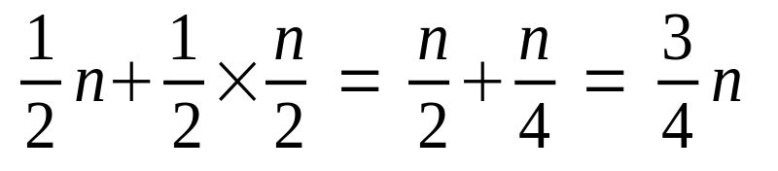
Typical Case of sequential (linear)
  The average describes the more typical case
  First, let the the entire cost be simplified to n
    Assume the target has a 50/50 chance of being in the array
      n comparisons are made: worst-case occurs 1/2 the time
    Assume if it's in a, it's as likely to be in one index as another
Half the time it is n comparisons, the other half it is n/2 comparisons
    So the typical case is 3/4 n comparisons
+
+

Slide 11
The Essence of Linear Search
Plot the function this is why sequential search is also
called linear search. As n increases, runtime forms a line
f(n)
75
45
n
60
100

Slide 12
Linear Search Continued
This equation is a polynomial: 3n + 3
The fastest growing term is the high-order term
The high order term (which could be n² or n³), represents the most important part of the analysis function
We refer to the rate of growth as the order of magnitude, which measure the rate of growth

Slide 13
Rate of Growth
  Imagine two functions:
f(n) = 100n g(n) = n² + n
    When n is small, which is the bigger function?
    When n is big, which is the bigger function?
    We can say: g(n) grows faster than f(n)

Slide 14
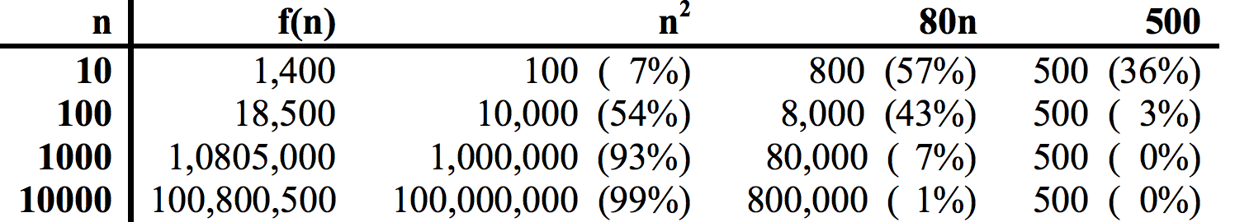
Rate of Growth, another view
Function growth and weight of terms as a percentage of all terms as n increases for
f(n) = n² + 80n + 500
Conclusion: consider highest order term with the coefficient dropped, also drop all lower order terms

Slide 15
Definition
  The asymptotic growth of an algorithm
    describes the relative growth of an algorithm as n gets very large
    With speed and memory increases doubling every two years, the asymptotic efficiency where n is very large is the thing to consider
    There are many sorting algorithm that are "on the order of" n² (there are roughly n×n instructions executed)
    Other algorithms are "on the order of" n×log₂n
      and this is a huge difference when n is very large

Slide 16
Constant Function
  Some functions don't grow with n
    If the sorting program initializes a few variables first, the time required does not change when n increases
    These statements run in constant time
      e.g. construct an empty List with capacity 20
    The amount of time can be described as a constant function f(n) = k, where k is a constant
    it takes ~0.0003 seconds no matter the size of n

Slide 17
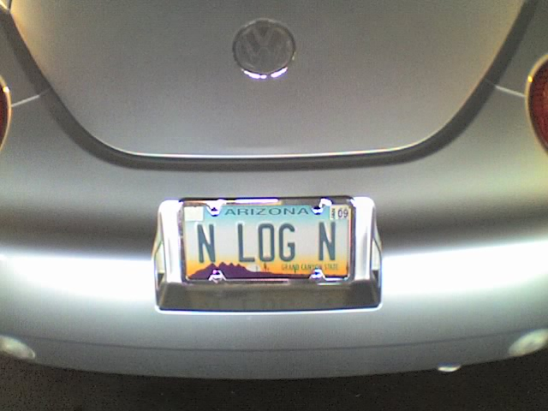
Big O
  Linear search is "on the order of n", which can be written as O(n) to describe the upper bound on the number of operations
  This is called big O notation
  Orders of magnitude:
O(1) constant (the size of n has no effect)
O(n) linear
O(log n) logarithmic
O(n log n) no other way to say it, John K’s License plate
O(n²) quadratic
O(n³) cubic
O(2^{n}) exponential

Slide 18
Binary Search
  We'll see that binary search can be a more efficient algorithm for searching
If the element in the middle is the target
report target was found and the search is done
if the key is smaller
search the array to the left
Otherwise
search the array to the right
  This process repeats until the target is found or there is nothing left to search
  Each comparison narrows search by half

Slide 19
Binary Search Harry
Data reference loop 1 loop 2
Bob
a[0]
a[1]
a[2]
a[3]
a[4]
a[5]
a[6]
a[7]
a[8]
left
mid
right
left
mid
right
Carl
Debbie
Evan
Froggie
Gene
Harry
Igor
Jose

Slide 20
How fast is Binary Search?
  Best case: 1
  Worst case: when target is not in the array
  At each pass, the "live" portion of the array is narrowed to half the previous size.
  The series proceeds like this:
    n , n/2, n/4, n/8, ...
  Each term in the series represents one comparison How long does it take to get to 1?
    This will be the number of comparisons

Slide 21
Binary Search (con.)
  Could start at 1 and double until we get to n
1, 2, 4, 8, 16, ... , k >= n or
2⁰, 2¹, 2², 2³, 2⁴, ... , 2^{c} >= n
  The length of this series is c+1
  The question is
    2 to what power c is greater than or equal to n?
      if n is 8, c is 3
      if n is 1024, c is 10
      if n is 16,777,216, c is 24
  Binary search runs O(log n) logarithmic

Slide 22
Comparing O(n) to O(log n)
Rates of growth and logarithmic functions
Power of 2 n log₂n
2⁴ 16 4
2⁸ 128 8
2¹² 4,096 12
2²⁴ 16,777,216 24

Slide 23
Graph Illustrating Relative Growth n, log n, n²
f(n)
n²
n
log n
n

Slide 24
Other logarithm examples
  The guessing game:
    Guess a number from 1 to 100
      try the middle, you could be right
      if it is too high
        check near middle of 1..49
      if it is too low
        check near middle of 51..100
    Should find the answer in a maximum of 7 tries
      If 1..250, a maximum of 2^{c} >= 250, c == 8
      If 1..500, a maximum of 2^{c} >= 500, c == 9
      If 1..1000, a maximum of 2^{c} >= 1000, c == 10

Slide 25
Logarithmic Explosion
  Assuming an infinitely large piece of paper that can be cut in half, layered, and cut in half again as often as you wish.
    How many times do you need to cut and layer until paper thickness reaches the moon?
    Assumptions
      paper is 0.002 inches thick
      distance to moon is 240,000 miles
        240,000 * 5,280 feet per mile * 12 inches per foot = 152,060,000,000 inches to the moon

Slide 26
Examples of Logarithmic Explosion
  The number of bits required to store a binary number is logarithmic add 1 bit to get much larger ints
    8 bits stored 256 values log₂256 = 8
    log 2,147,483,648 = 31
  The inventor of chess asked the Emperor to be paid like this:
    1 grain of rice on the first square, 2 on the next, double grains on each successive square 2⁶³

Slide 27

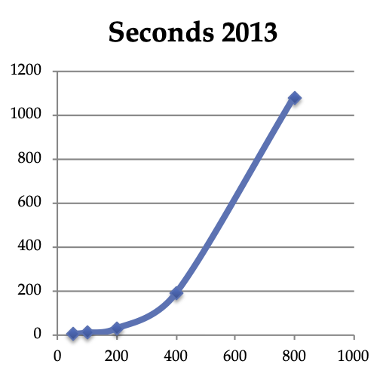
Compare Sequential and Binary Search
  Output from CompareSearches.java (1995)
Search for 20000 objects
Binary Search
#Comparisons: 267248
Average: 13
Run time: 20ms
Sequential Search
#Comparisons: 200010000
Average: 10000
Run time: 9930ms
Difference in comparisons : 199742752
Difference in milliseconds: 9910

Slide 28
O(n²) quadratic
  O(n²) reads on the order of n squared or quadratic
  When n is small, rates of growth don’t matter
  Quadratic algorithms are greatly affected by increases in n
    Consider the selection sort algorithm
      Find the largest, n-1 times

Slide 29
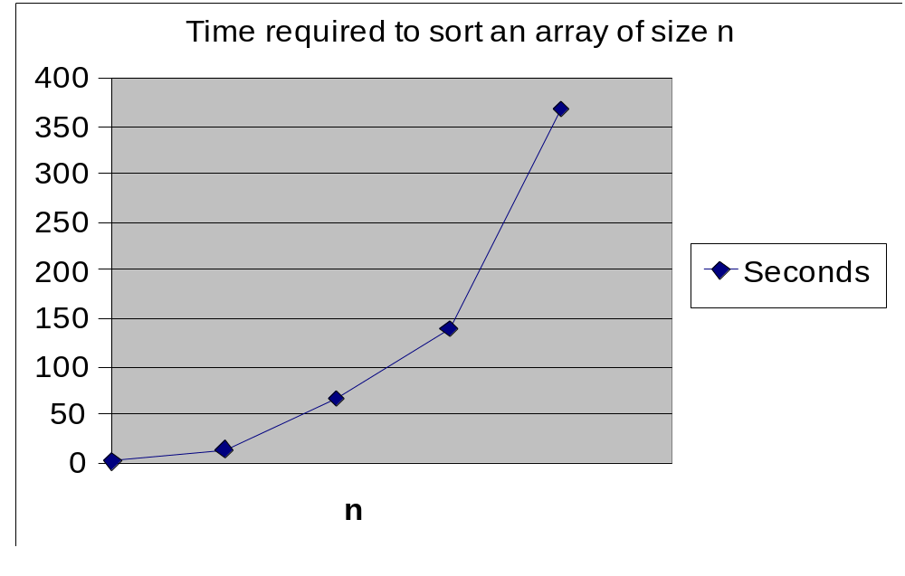
Actual observed data for O(n²) sort
1 10 20 3 0 40
in thousands

Slide 30
Two O(n²) algorithms
  Many known sorting algorithms are O(n²)
  Given n points, find the pair that are closest
Compare p1 with p2, p3, p4, p5 (4 comparisons)
Compare p2 with p3, p4, p5 (3 comparisons)
Compare p3 with p4, p5 (2 comparisons)
Compare p4 with p5 (1 comparisons)
    When n is 5, make 10 comparisons
    In general, #comparisons is
n(n-1) / 2 == n²/2 - n/2
    highest order term is n², drop ½ and runtime is O(n²)

Slide 31
O(n³) algorithms
  Matrix Multiplication (naïve):
  for(int i = 0; i < m.length; i++) {
  for(int j = 0; j < m2.length - 1; j++) {
  for(int k = 0; k < m2.length; k++){
  m[i][j] += m[i][k] * m2[k][j];
  }
  }
  }

Slide 32
Big O and Style Guidelines
  Big O is similar to saying the runtime is less than or equal to Big O notation.
    O(f) is an upper bound
  Don't use constants or lower-order terms
    These are no-nos for now (you will use coefficients in C Sc 345)
O(n² + n) should be written O(n²)
O(5500n) should be written O(n)
O(2.5n) should be written O(n)

Slide 33
Properties of Big-O
Summarizing two main properties
If f(n) is a sum of several terms, the one with the largest growth rate is kept, and all others omitted
If f(n) is a product of several factors, any constants (terms in the product that do not depend on n) are omitted – which means you can drop coefficients

Slide 34
Properties of Big-O
We can drop coefficient
Example:
f(n) = 100*n
then f(n) is O(n)

Slide 35
Summation of same Orders
The property is useful when an algorithm contains several loops of the same order
Example:
f(n) is O(n)
f2(n) is O(n)
then f(n) + f2(n) is O(n) + O(n), which is O(n)

Slide 36
Summation of different Orders
This property works because we are only concerned with the term of highest growth rate
Example:
f₁(n) is O(n²)
f₂(n) is O(n)
so f₁(n) + f₂(n) = n² + n is O(n²)

Slide 37
Product
This property is useful for analyzing segments of an algorithm with nested loops
Example:
f₁(n) is O(n²)
f₂(n) is O(n)
then f₁(n) x f₂(n) is O(n²) x O(n), which is O(n³)

Slide 38
Limitations of Big-Oh Analysis
  Constants sometimes make a difference
    n log n may be faster than 10000n
    Doesn't differentiate between data cache memory, main memory, and data on a disk--there is a huge time difference to access disk data
      thousands of times slower
    Worst case doesn't happen often
      it's an overestimate

Slide 39
Quick Analysis
  Can be less detailed
  Running time of nested loops is
    the product of each loop's number of iterations
  Several consecutive loops
    the longest running loop
      3n is O(n) after all

Slide 40
Runtimes with for loops
int n = 1000;
int[] x = new int[n];
  O(n)
for(int j = 0; j < n; j++)
x[j] = 0;
  O(n²)
int sum = 0;
for (int j = 0; j < n; j++)
for (int k = 0; k < n; k++)
sum += j * k;

Slide 41
Run times with for loops
  O(n³)
for (int j = 0; j < n; j++)
for (int k = 0; k < n; k++)
for (int l = 0; l < n; l++)
sum += j * k * l;
  O(n)
for (int j = 0; j < n; j++)
sum++;
for (int j = 0; j < n; j++)
sum--;
  O(log n)
for (int j = 1; j < n; j = 2 * j)
sum += j;

Slide 42
Analyze this
public void swap(int[] a, int left, int right) {
int temp = array[left];
array[left] = array[right];
array [right] = temp;
}

Slide 43
Analyze that
for (int j = 0; j < n; j++)
sum += l;
for (int k = 0; k < n; k++)
sum += l;
for (int l = 0; l < n; l++)
sum += l;

Slide 44
Analyze that
for (int j = 0; j < n; j++)
for (int k = 0; k < n; k++)
sum += k + l;
for (int l = 0; l < n; l++)
sum += l;

Slide 45
Analyze this
for (int top = 0; top < n - 1; top++) {
int smallestIndex = top;
for (int index = top; index < n; index++) {
if(a[index] < a[smallestIndex])
smallestIndex = index;
}
// Swap smallest to the top index
swap(a, top, smallestIndex);
}

